Slide 1


SNOW-FLAKE (WARD 100) Service Delivery
THEMBISA Walk-IN CENTRE
Area: Ward 100 (Snow-flake)
Date: 13 March 2025

Slide 2
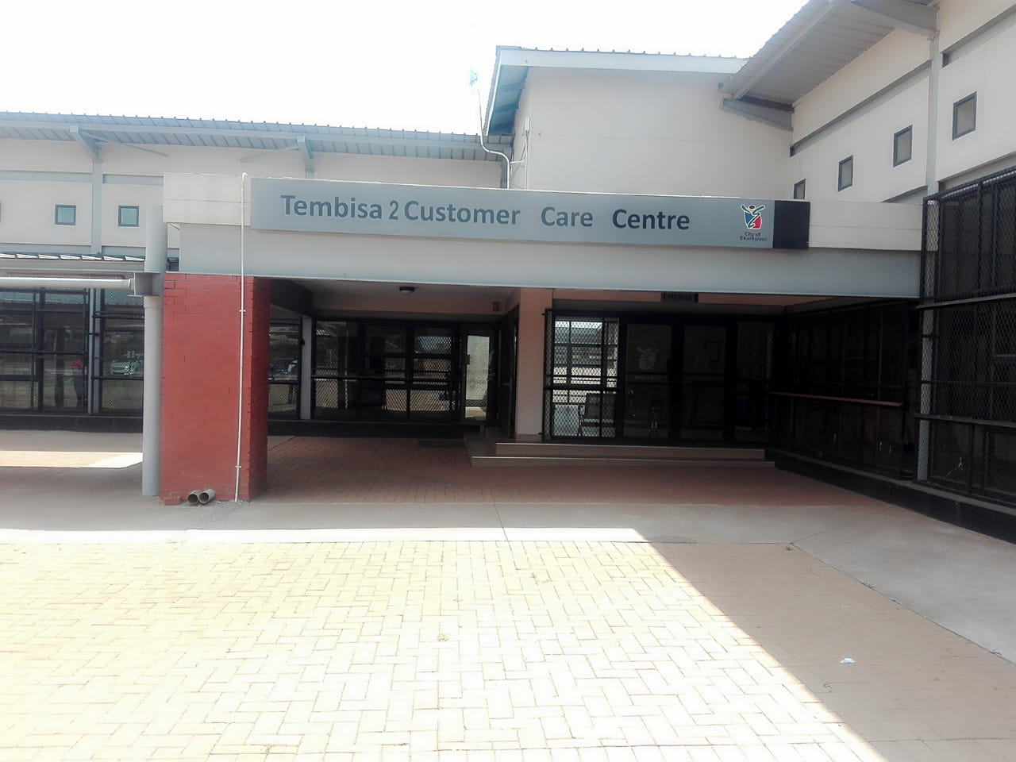
TEMBISA
WARD PROFILE

Slide 3
TEMBISA WIC
 | Councilor | Areas
MMC Deployed | MMC Sizakele Masuku (Service Delivery MMC Doctor Xhakaza (Governance)
WIC, CRM Manager | Ms. Makhosazana Dhladhla | Tembisa 1 & 2
Ward No. | Councilor | Areas
01 | Cllr. Derek Edwin Thomson | Clayville Ext 26-33. Midstream
02 | Cllr. Thato Mashiane | Tswelopele Ext.1,Zones 04,07,08,09,10,11,&12,Duduza North: Block A and half of Bock E,D,E&EE.
03 | Cllr. Kedibone Yvonne Machete | Winnie Mandela Zone 02,03, 05, 06, 07, 08, 10
07 | Cllr. Thabang Asaph Jiyane | Temong, Maokeng ,Maokeng Ext., Tsenelong & Ext, Leboeng.
89 | Cllr Tsoarelo Pudi | Greater Hospital View, L&J Farm, Winnie Mandela Zone 1,2 &3, Clayville East & West, Clayville Ext.21,27&34, Midrand Village.
100 | Cllr. Bennet Mluleki Khota | Sethokga Hostel, Sethokga Section, Ext 07, Ext 9, Moriting, Freedom Square, Hospital Hill.
102 | Cllr. Madimetja Mabye | Duduza, Clayville Ext.45,71,76,79 & 80(Partly), 9, 10, 12, Tswelopele Ext 1 ,6 & 8 Tswelopele Transit.

Slide 4
TEMBISA WIC
 | Councilor | Areas
MMC Deployed | MMC Sizakele Masuku (Service Delivery MMC Doctor Xhakaza (Governance)
WIC, CRM Manager | Ms. Makhosazana Dhladhla | Tembisa 1 & 2
Ward No. | Councilor | Areas
04 | Daniel Themba Mbathane | Mqantsa, Ecaleni, Oakmoor Ext 7, Xubeni, Sedibeng, Emoyeni, Ematikweni, Elidinga Phase 2
05 | Francis Malesela Kgafela | Mashemong, Makholong, Matikweni, Kopanong, Tshepo, Tlamatlama
06 | Patrick Tleane | Endulwini, Emkhathini, Ibazelo, Madelakufa 1, Iqgaqga and Ext, Part of Esithama, Part of Emoyeni, Elidinga Phase 1 Isiziba.
08 | Lucky Nhlanhla Ntshingila | Emangweni, Ililiba, Isekelo, Madelakufa 2, Esselen Park Ext 1, 2 & 3
09 | Nomvula Malinga | Motsu, Difateng, Seotloane, Moteong, Sophiatown, Teanong and Dali Mpofu informal Settlements.
14 | Adelaide Lindiwe Mnguni | Ethafeni, Isivane, Inxiweni, Jiyane, Emfihlweni, , Isiphetwini, Ibaxa,
90 | Hendrick Selwana | Vusumuzi Informal Settlement, Emhlangeni, Ehlanzeni Hostel,Dumping, Nkaning Informal Settlement

Slide 5
02
Rating

Slide 6
Summary of Department Commitments
The table below reflect the performance of individual departments in line with the commitments made to the Service Delivery Challenges:
Department | Finalised | In Progress | Outstanding | Total
Metro Parks | 0 | 0 | 0 | 0
Water & Sanitation | 0 | 0 | 0 | 0
Road & Stormwater | 0 | 0 | 0 | 0
TOTAL | 0 | 0 | 0 | 69

Slide 7
03
Service Delivery Issues

Slide 8
Ward 100
Service Delivery Issues

Slide 9
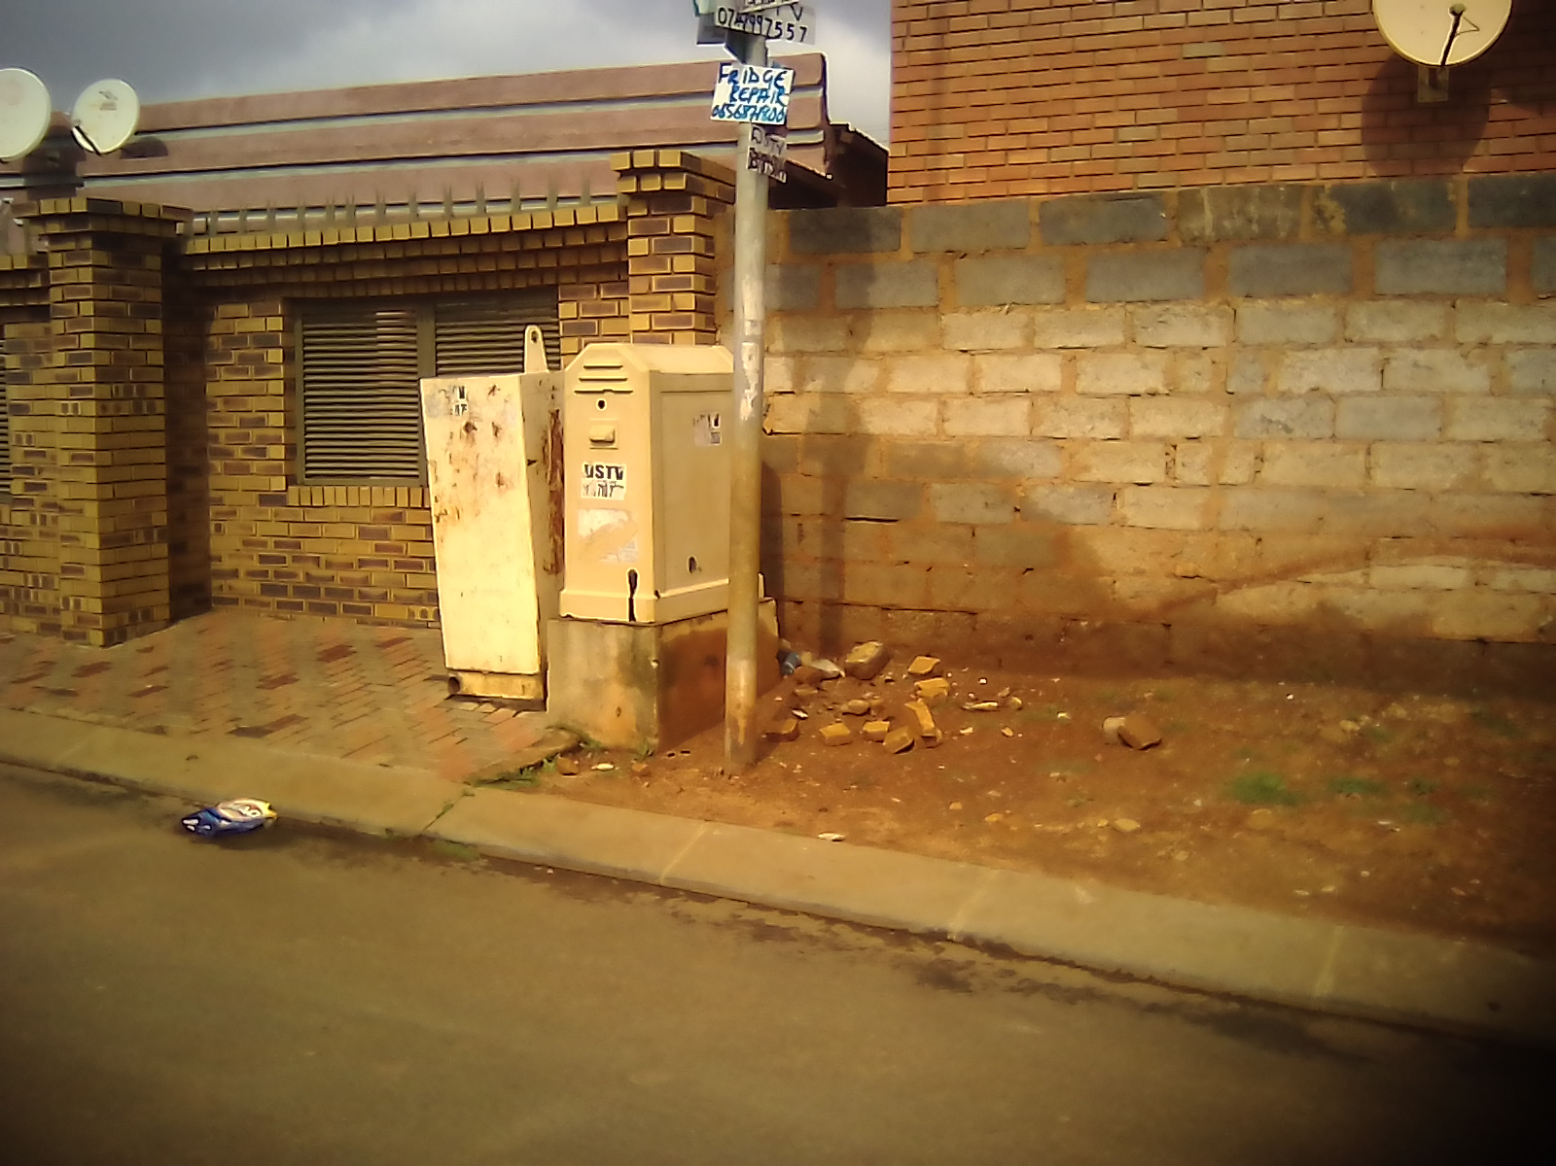
Service Delivery Ward Challenges
Wards | Challenge & area | Responsible Department | Rating | Departmental Response | Commitment Made | Current status/ After picture
Ward 100 | Streetlights not working @ 5789/19 Ref: 0787/2025/03/13 | Energy |  | Outstanding | Energy team will be implored to fix the streetlight
 | Streetlights not working @5789/9 Ref: 0810/2025/03/13 |  |  | Outstanding | Energy team will be implored to fix the streetlight
 | Electric box need to be fixed Ref: 0761/2025/03/13 | Energy |  | Outstanding | Energy committed to replace the box cap.

Slide 10
Ward 89
Service Delivery Water & Sanitation

Slide 11
Service Delivery Ward Challenges
Wards | Challenge & area | Responsible Department | Rating | Departmental Response | Commitment Made | Current status/ After picture
Ward 100 |  | Water & Sanitation

Slide 12
Ward 89
Service Delivery Road & Stormwater

Slide 13
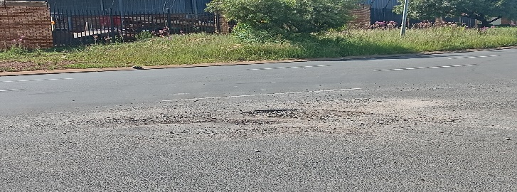
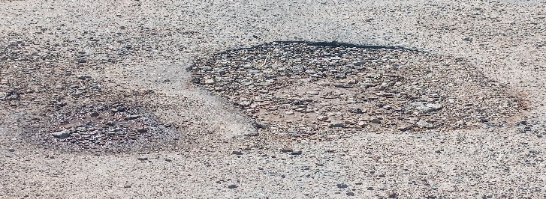
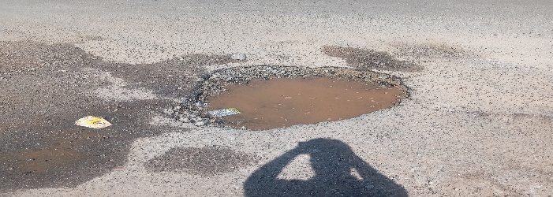
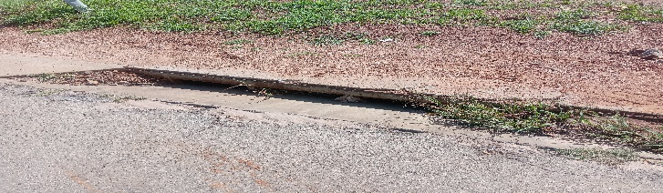
Service Delivery Ward Challenges
Wards | Challenge & area | Responsible Department | Rating | Departmental Response | Commitment Made | Current status/ After picture
Ward 89 | Pothole Olifantsfontein Koppel Street Ref: 1940-2025/02/24 | Road & Stormwater |  | Outstanding | Done 30-01-2025
 | Pothole Olifantsfontein Southward Street Ref:
 | Pothole Olifantsfontein Southward Street Ref: |  |  | Outstanding | Done 7 March 2025
 | Pothole Olifantsfontein opposite Coca Cola Axle Drive Ref: |  |  | Outstanding | Done 14 March 2025
 | Blocked Stormwater Olifantsfontein Axle Drive Ref:
 | Blocked Stormwater Olifantsfontein Axle Drive Street Ref: |  |  | Outstanding | To be done 11 April 2025

Slide 14
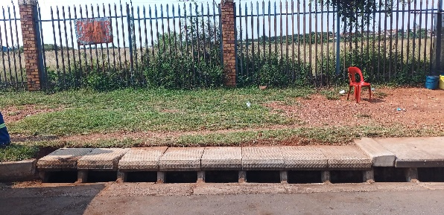
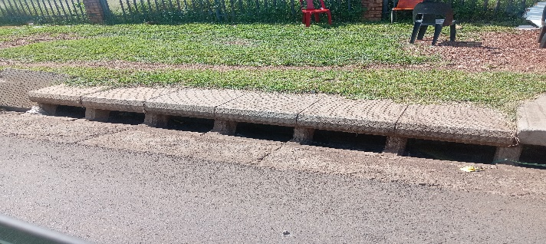

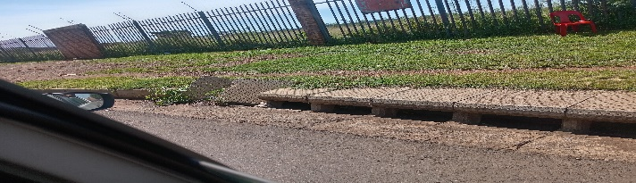
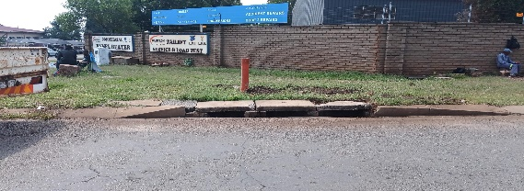
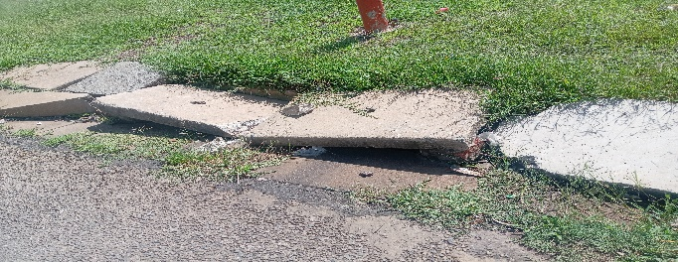
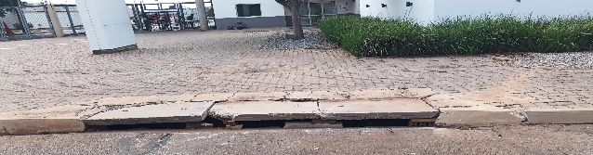
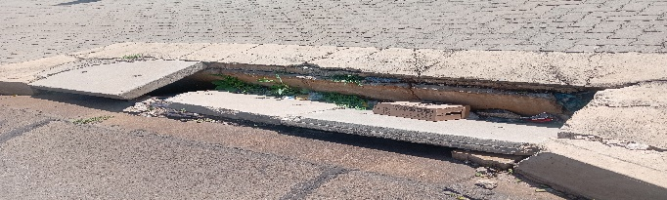
Service Delivery Ward Challenges
Wards | Challenge & area | Responsible Department | Rating | Departmental Response | Commitment Made | Current status/ After picture
Ward 89 | Blocked Stormwater Olifantsfontein opposite Allied Building Street Ref: | Road & Stormwater |  | Done 25 March 2025
 | Blocked Stormwater Olifantsfontein opposite Allied Building Street Ref:
 | Pothole Olifantsfontein Southward Street Ref: |  |  | Done 25 March 2025
 | Damage Stormwater Olifantsfontein Axle Road Ref: |  |  | Done 25 March 2025
 | Damage Stormwater Olifantsfontein opposite Clover Company Ref:
 | Blocked Stormwater Olifantsfontein Axle Drive Street Ref: |  |  | Done 25 March 2025

Slide 15
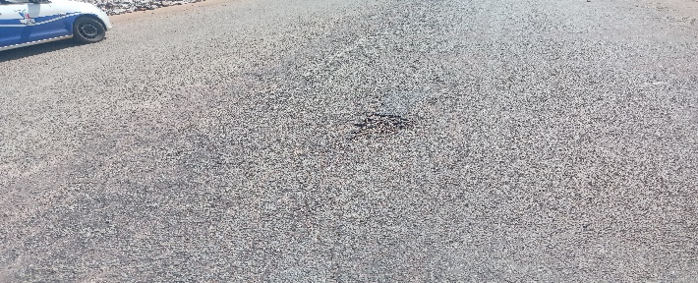
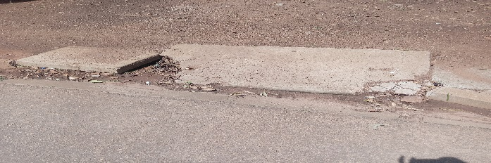

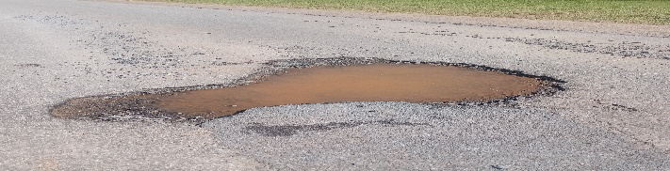
Service Delivery Ward Challenges
Wards | Challenge & area | Responsible Department | Rating | Departmental Response | Commitment Made | Current status/ After picture
Ward 89 | Road Marking Whole Olifantsfontein Ref: | Road & Stormwater |  | Outstanding | To be done 11 April 2025
 | Damage Stormwater Opposite BP Filling Station Ref:
 | Pothole Olifantsfontein Southward Street Ref: |  |  | Outstanding | To be done 11 April 2025
 | Damage Stormwater Olifantsfontein Ultra Liquor Store Ref: |  |  | Outstanding | To be done 11 April 2025
 | Pothole Olifantsfontein Ultra Liquor Ref:
 | Blocked Stormwater Olifantsfontein Axle Drive Street Ref: |  |  | Outstanding | Done 4 MARCH 2025

Slide 16
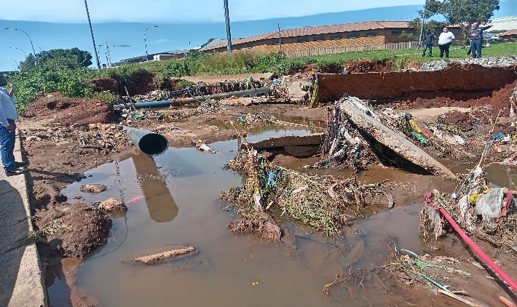
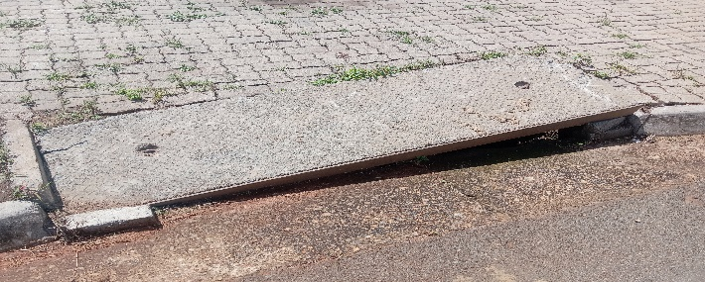
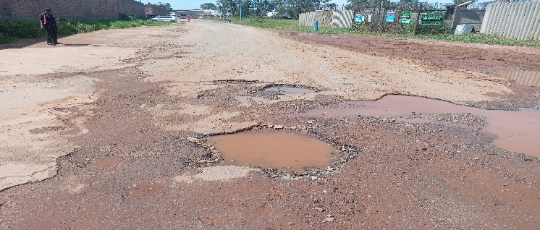
Service Delivery Ward Challenges
Wards | Challenge & area | Responsible Department | Rating | Departmental Response | Commitment Made | Current status/ After picture
 | Damage water channel Olifantsfontein next to Man Company Ref: | Road & Stormwater Water; Energy |  | Outstanding | Consultants to do: Project Feasibility & Initial Assessment, Surveying & Data Collection, Hydraulic & Structural Design and Regulatory Approvals & Permits as soon as a budget is made available after which re-construction work will commence.
 | Blocked Stormwater Olifantsfontein next to Man Company Ref:
 | Blocked Stormwater Olifantsfontein Axle Drive Street Ref: |  |  | Outstanding | To be done 11 April 2025
 | Pothole Olifantsfontein Westview Street Ref: 2311-2025/02/24 |  |  | Outstanding | To be done on or before 30 April 2025

Slide 17
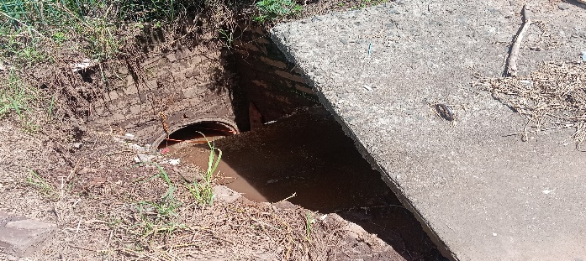
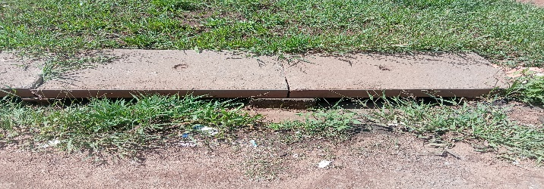
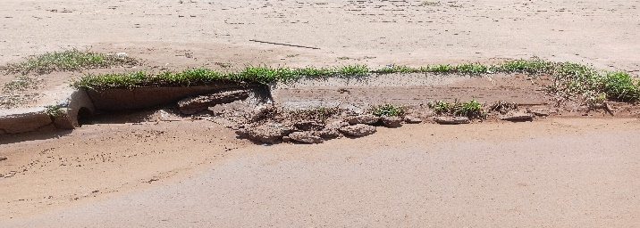

Service Delivery Ward Challenges
Wards | Challenge & area | Responsible Department | Rating | Departmental Response | Commitment Made | Current status/ After picture
Ward 89 | Stormwater drain damage Olifantsfontein Westview Street Ref: 2325-2025/02/24 | Road & Stormwater |  | Outstanding | To be done 11 April 2025
 | Stormwater drain blocked Olifantsfontein Beka lane Street Ref:2346-2025/02/05
 | Pothole Olifantsfontein Southward Street Ref: |  |  | Outstanding | To be done 11 April 2025
 | Stormwater Damage Olifantsfontein Industrial Road Ref: |  |  | Outstanding | To be done 11 April 2025
 | Stormwater Damage Olifantsfontein Nut Road Ref:
 | Blocked Stormwater Olifantsfontein Axle Drive Street Ref: |  |  | Outstanding | To be done 11 April 2025

Slide 18
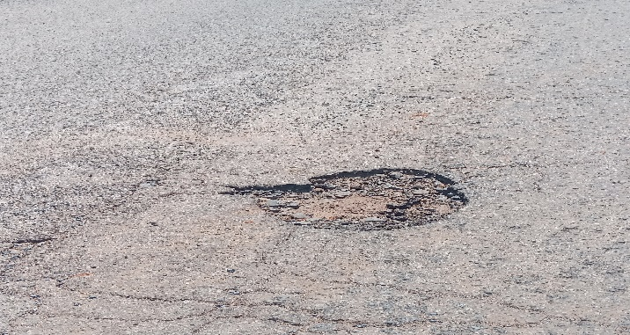
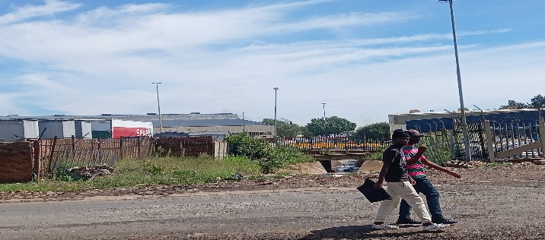
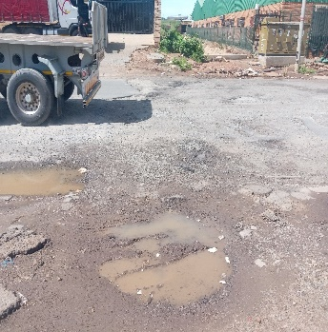
Service Delivery Ward Challenges
Wards | Challenge & area | Responsible Department | Rating | Departmental Response | Commitment Made | Current status/ After picture
Ward 89 | Potholes Olifantsfontein Nut Road Ref: | Road & Stormwater |  | Outstanding | Done 4 March 2025
 | Damage water channel Olifantsfontein next to Man Company Ref:
 | Pothole Olifantsfontein Southward Street Ref: |  |  | Outstanding | Done 11 April 2025
 | Tar road washed away Olifantsfontein opposite Spar & Axle Road Ref: |  |  | Outstanding | Olifantsfontein stormwater channel requires maintenance/cleaning and complete reconstruction.

Slide 19
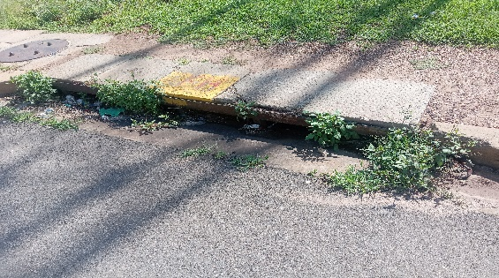
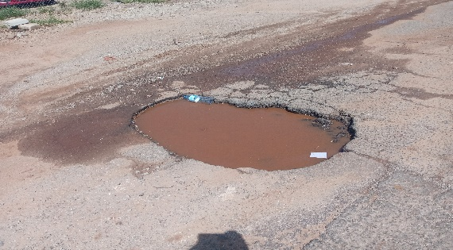
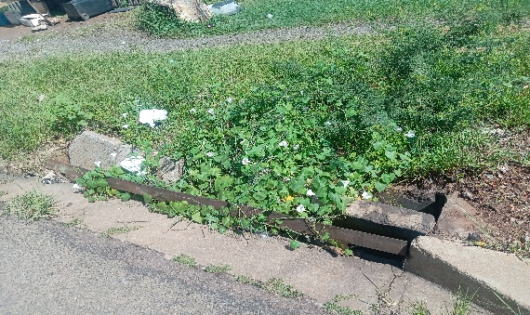
Service Delivery Ward Challenges
Wards | Challenge & area | Responsible Department | Rating | Departmental Response | Commitment Made | Current status/ After picture
Ward 89 | Blocked Stormwater Olifantsfontein Axle Drive Street Ref: | Road & Stormwater |  | Outstanding | To be done 11 April 2025
 | Pothole Olifantsfontein next to BP Filling Station Ref: |  |  | Outstanding | Done 14 March 2025
 | Damage & blocked Stormwater Olifantsfontein opposite Spar & Axle Road Ref: 2404-2025/02/24 |  |  | Outstanding | To be done 11 April 2025

Slide 20
Service Delivery Ward Challenges
Wards | Challenge & area | Responsible Department | Rating | Departmental Response | Commitment Made | Current status/ After picture
Ward 89 | Damage Stormwater Olifantsfontein Beksteen Road Ref: | Road & Stormwater |  | Outstanding | To be done 11 April 2025
 | Pothole Olifantsfontein opposite Adcock Ingram Ref: |  |  | Outstanding | Done 7 MARCH 2025
 | Pothole Whole Street Olifantsfontein Hammer Road Ref: |  |  | Outstanding | To be done 11 April 2025
 | Blocked Stormwater Olifantsfontein Hammer Street Ref: |  |  | Outstanding | To be done 11 April 2025
 | Damage Stormwater Olifantsfontein opposite Clover Company Ref: |  |  | Outstanding

Slide 21
Ward 89
Road and Stormwater

Slide 22
Service Delivery Ward Challenges
Wards | Challenge & area | Responsible Department | Rating | Departmental Response | Commitment Made | Current status/ After picture
Ward 89 | Sidewalks, road shoulders and cleaning of road surface assessment Spanner Road: | Road and Stormwater |  | Outstanding
 | Sidewalks, road shoulders and cleaning of road surface assessment Upper Upper Spanner Road: |  |  | Outstanding
 | Sidewalks, road shoulders and cleaning of road surface assessment Industry Road: |  |  | Outstanding
 | Sidewalks, road shoulders and cleaning of road surface assessment Nail Road |  |  | Outstanding

Slide 23
Service Delivery Ward Challenges
Wards | Challenge & area | Responsible Department | Rating | Departmental Response | Commitment Made | Current status/ After picture
Ward 89 | Sidewalks, road shoulders and cleaning of road surface assessment Southward Drive: | Road and Stormwater |  | Outstanding
 | Sidewalks, road shoulders and cleaning of road surface assessment Axle Drive: |  |  | Outstanding
 | Sidewalks, road shoulders and cleaning of road surface assessment Olifantsfontein Road: |  |  | Outstanding

Slide 24
Service Delivery Ward Challenges
Wards | Challenge & area | Responsible Department | Rating | Departmental Response | Commitment Made | Current status/ After picture
Ward 89 | Sidewalks, road shoulders and cleaning of road surface assessment Bank Street: | Road and Stormwater |  | Outstanding
 | Sidewalks, road shoulders and cleaning of road surface assessment Porcelain Road: |  |  | Outstanding
 | Sidewalks, road shoulders and cleaning of road surface assessment MainRoad (Service Road): |  |  | Outstanding

Slide 25
Ward 89
Road and Stormwater

Slide 26
Service Delivery Ward Challenges
Wards | Challenge & area | Responsible Department | Rating | Departmental Response | Commitment Made | Current status/ After picture
Ward 89 | Clayville Industrial – Traffic signal assessment Olifantsfontein Road and Spanner Road: | Road and Stormwater |  | Outstanding
 | Clayville Industrial – Traffic signal assessment Olifantsfontein Road and Industry Road: |  |  | Outstanding
 | Clayville Industrial – Traffic signal assessment Axle Drive: |  |  | Outstanding
 | Clayville Industrial – Traffic signal assessment Olifantsfontein Road and Reginald Street:

Slide 27
Service Delivery Ward Challenges
Wards | Challenge & area | Responsible Department | Rating | Departmental Response | Commitment Made | Current status/ After picture
Ward 89 | Clayville Industrial – Traffic signs and road markings assessment Olifantsfontein Upper Spanner Road: | Road and Stormwater |  | Outstanding
 | Clayville Industrial – Traffic signal assessment Spanner Road: |  |  | Outstanding
 | Clayville Industrial – Traffic signal assessment Industry Road: |  |  | Outstanding
 | Clayville Industrial – Traffic signal assessment Olifantsfontein Road and Reginald Street:

Slide 28
Service Delivery Ward Challenges
Wards | Challenge & area | Responsible Department | Rating | Departmental Response | Commitment Made | Current status/ After picture
Ward 89 | Clayville Industrial – Traffic signs and road markings assessment Olifantsfontein Olifantsfontein Road: | Road and Stormwater |  | Outstanding
 | Clayville Industrial – Traffic signal assessment Park Street: |  |  | Outstanding
 | Clayville Industrial – Traffic signal assessment Westview Road: |  |  | Outstanding
 | Clayville Industrial – Traffic signal assessment Nail Road:

Slide 29
Service Delivery Ward Challenges
Wards | Challenge & area | Responsible Department | Rating | Departmental Response | Commitment Made | Current status/ After picture
Ward 89 | Clayville Industrial – Traffic signs and road markings assessment Olifantsfontein Axle Drive: | Road and Stormwater |  | Outstanding
 | Clayville Industrial – Traffic signal assessment Porcelain Road: |  |  | Outstanding
 | Clayville Industrial – Traffic signal assessment Pebble Lane: |  |  | Outstanding
 | Clayville Industrial – Traffic signal assessment Keramiek Street:

Slide 30
Service Delivery Ward Challenges
Wards | Challenge & area | Responsible Department | Rating | Departmental Response | Commitment Made | Current status/ After picture
Ward 89 | Clayville Industrial – Traffic signs and road markings assessment Olifantsfontein Bank Street: | Road and Stormwater |  | Outstanding
 | Clayville Industrial – Traffic signal assessment Hammer Road: |  |  | Outstanding
 | Clayville Industrial – Traffic signal assessment Baksteen Road: |  |  | Outstanding
 | Clayville Industrial – Traffic signal assessment Koppel Road:

Slide 31
Service Delivery Ward Challenges
Wards | Challenge & area | Responsible Department | Rating | Departmental Response | Commitment Made | Current status/ After picture
Ward 89 | Clayville Industrial – Traffic signs and road markings assessment Olifantsfontein Baksteen Road: | Road and Stormwater |  | Outstanding

Slide 32
Ward 89
Road and Stormwater

Slide 33
Service Delivery Ward Challenges
Wards | Challenge & area | Responsible Department | Rating | Departmental Response | Commitment Made | Current status/ After picture
Ward 89 | Clayville Industrial – Water Canal Axle Drive & Spanner Road - Between the R562 and Olifantsfontein Road | Road and Stormwater |  | Outstanding

Slide 34
Ward 89
Water and Sanitation

Slide 35
Service Delivery Ward Challenges
Wards | Challenge & area | Responsible Department | Rating | Departmental Response | Commitment Made | Current status/ After picture
Ward 89 | Clayville Industrial – Water infrastructure assessment Spanner Road: | Water and Sanitation |  | Outstanding
 | Clayville Industrial – Water infrastructure assessment Industry Road and Nail Avenue: |  |  | Outstanding
 | Clayville Industrial – Water infrastructure assessment Park Street: Excavation left open |  |  | Outstanding
 | Clayville Industrial – Water infrastructure assessment Park Street: Axle Drive: |  |  | Outstanding

Slide 36
Service Delivery Ward Challenges
Wards | Challenge & area | Responsible Department | Rating | Departmental Response | Commitment Made | Current status/ After picture
Ward 89 | Clayville Industrial – Water infrastructure assessment Main Road (Service Road): Excavation left open and infrastructure | Water and Sanitation |  | Outstanding
 | Clayville Industrial – Water infrastructure assessment Excavation material left after the installation of the water pipeline. |  |  | Outstanding
 | Clayville Industrial – Water infrastructure assessment Excavation material left after the installation of the water pipeline which also resulted in damage to the storm water pipeline. |  |  | Outstanding

Slide 37
Ward 89
Water and Sanitation

Slide 38
Service Delivery Ward Challenges
Wards | Challenge & area | Responsible Department | Rating | Departmental Response | Commitment Made | Current status/ After picture
Ward 89 | Clayville Industrial – Sewer infrastructure assessment Spanner Road: | Water and Sanitation |  | Outstanding
 | Clayville Industrial – Sewer infrastructure assessment Industry Road: |  |  | Outstanding
 | Clayville Industrial – Sewer infrastructure assessment Westview Road: |  |  | Outstanding
 | Clayville Industrial – Sewer infrastructure assessment Porcelain Road: |  |  | Outstanding

Slide 39
Service Delivery Ward Challenges
Wards | Challenge & area | Responsible Department | Rating | Departmental Response | Commitment Made | Current status/ After picture
Ward 89 | Clayville Industrial – Sewer infrastructure assessment Hammer Road: | Water and Sanitation |  | Outstanding

Slide 40
Ward 89
Energy Department

Slide 41
Service Delivery Ward Challenges
Wards | Challenge & area | Responsible Department | Rating | Departmental Response | Commitment Made | Current status/ After picture
Ward 89 | Streetlight assessment Main Road (M18) – Between the R562 and Olifantsfontein Road: Number of streetlights & High masts lights – 40 Number of lights working & Comments - 31 | Energy Department |  | Outstanding
 | Streetlight assessment Main Road (M18) – Between Park Street and Premier Street: Number ofstreetlights & High masts lights – 29 Number of lights working & Comments - 0 |  |  | Outstanding
 | Streetlight assessment Main Road (M18) – Between Premier Street and Porcelain Road: Number ofstreetlights & High masts lights – 29 Number of lights working & Comments - 0 |  |  | Outstanding

Slide 42
Service Delivery Ward Challenges
Wards | Challenge & area | Responsible Department | Rating | Departmental Response | Commitment Made | Current status/ After picture
Ward 89 | Streetlight assessment Premier Street – Between Main Road (M18) and TurkStreet:Olifantsfontein Road: Number of streetlights & High masts lights – 06 Number of lights working & Comments - 0 | Energy Department |  | Outstanding
 | Porcelain Road – Between Main Road (M18) and Keramiek Street Number ofstreetlights & High masts lights – 11 Number of lights working & Comments - 0 |  |  | Outstanding
 | Porcelain Road – Between Keramiek Street and the Cul-de-sac: Number ofstreetlights & High masts lights – 18 Number of lights working & Comments - 01 |  |  | Outstanding

Slide 43
Service Delivery Ward Challenges
Wards | Challenge & area | Responsible Department | Rating | Departmental Response | Commitment Made | Current status/ After picture
Ward 89 | Streetlight assessment Premier Street – Between Main Road (M18) and TurkStreet:Olifantsfontein Road: Number of streetlights & High masts lights – 11 Number of lights working & Comments - 0 | Energy Department |  | Outstanding
 | Keramiek Street: Street Number ofstreetlights & High masts lights – 09 Number of lights working & Comments - 0 |  |  | Outstanding
 | Porcelain Road – Between Main Road (M18) and the M57: Number of streetlights & High masts lights – 29 Number of lights working & Comments - 0 |  |  | Outstanding

Slide 44
Service Delivery Ward Challenges
Wards | Challenge & area | Responsible Department | Rating | Departmental Response | Commitment Made | Current status/ After picture
Ward 89 | Westview Road: Olifantsfontein Road: Number of streetlights & High masts lights – 08 Number of lights working & Comments - 0 | Energy Department |  | Outstanding
 | Park Street Number of streetlights & High masts lights – 08 Number of lights working & Comments – 0 Olifantsfontein Road – Between Industry Road and Westview Road: Number of streetlights & High masts lights – 03 Number of lights working & Comments – 0 |  |  | Outstanding
 | Park Street: Number of streetlights & High masts lights – 01 Number of lights working & Comments - 0 |  |  | Outstanding

Slide 45
Service Delivery Ward Challenges
Wards | Challenge & area | Responsible Department | Rating | Departmental Response | Commitment Made | Current status/ After picture
Ward 89 | Olifantsfontein road – between industry road and West View Road Number of streetlights & High masts lights – 03 Number of lights working & Comments - 0 | Energy Department |  | Outstanding
 | Park Street Number of streetlights & High masts lights – 08 Number of lights working & Comments – 0 Olifantsfontein Road – Between Industry Road and Westview Road: Number of streetlights & High masts lights – 03 Number of lights working & Comments – 0 |  |  | Outstanding
 | Olifantsfontein and Spanner Road Number of streetlights & High masts lights – 04 Number of lights working & Comments – 0
 | Southward Drive – Between the R562 and Olifantsfontein Road: Number of streetlights & High masts lights – 01 Number of lights working & Comments - 0 |  |  | Outstanding

Slide 46
Ward 89
Waste Management

Slide 47
Service Delivery Ward Challenges
Wards | Challenge & area | Responsible Department | Rating | Departmental Response | Commitment Made | Current status/ After picture
Ward 89 | Illegal dumping, litter picking and cleaning assessment Spanner Road: | Waste Management |  | Outstanding
 | Illegal dumping, litter picking and cleaning assessment Industry Road: |  |  | Outstanding
 | Koppel Road |  |  | Outstanding

Slide 48
Service Delivery Ward Challenges
Wards | Challenge & area | Responsible Department | Rating | Departmental Response | Commitment Made | Current status/ After picture
Ward 89 | Illegal dumping, litter picking and cleaning assessment Bank Street: | Waste Management |  | Outstanding
 | Illegal dumping, litter picking and cleaning assessment : Main Road Service Street |  |  | Outstanding
 | Southward drive |  |  | Outstanding

Slide 49
Service Delivery Ward Challenges
Wards | Challenge & area | Responsible Department | Rating | Departmental Response | Commitment Made | Current status/ After picture
Ward 89 | Illegal dumping, litter picking and cleaning assessment Baron Road: | Waste Management |  | Outstanding

Slide 50
Ward 89
Meter Park

Slide 51
Service Delivery Ward Challenges
Wards | Challenge & area | Responsible Department | Rating | Departmental Response | Commitment Made | Current status/ After picture
Ward 89 | Clayville Industrial – Grass cutting and tree pruning assessment Spanner Road: | Metro Park |  | Outstanding
 | Clayville Industrial – Grass cutting and tree pruning assessment Olifantsfontein Road and Industry Road: |  |  | Outstanding
 | Clayville Industrial – Grass cutting and tree pruning assessment Nut Road: |  |  | Outstanding
 | Clayville Industrial – Grass cutting and tree pruning assessment Koppel Road: |  |  | Outstanding

Slide 52
Service Delivery Ward Challenges
Wards | Challenge & area | Responsible Department | Rating | Departmental Response | Commitment Made | Current status/ After picture
Ward 89 | Clayville Industrial – Grass cutting and tree pruning assessment Olifantsfontein Road: | Metro Park |  | Outstanding
 | Clayville Industrial – Grass cutting and tree pruning assessment Park Street: |  |  | Outstanding
 | Clayville Industrial – Grass cutting and tree pruning assessment Westview Road: |  |  | Outstanding
 | Clayville Industrial – Grass cutting and tree pruning assessment Main Road (Service Road): |  |  | Outstanding

Slide 53
Service Delivery Ward Challenges
Wards | Challenge & area | Responsible Department | Rating | Departmental Response | Commitment Made | Current status/ After picture
Ward 89 | Clayville Industrial – Grass cutting and tree pruning assessment Nail Road: | Metro Park |  | Outstanding
 | Clayville Industrial – Grass cutting and tree pruning assessment Axle Drive: |  |  | Outstanding
 | Clayville Industrial – Grass cutting and tree pruning assessment Pebble Lane:

Slide 54
Service Delivery Ward Challenges
Wards | Challenge & area | Responsible Department | Rating | Departmental Response | Commitment Made | Current status/ After picture
Ward 89 | Clayville Industrial – Grass cutting and tree pruning assessment Southward Drive: | Metro Park |  | Outstanding
 | Clayville Industrial – Grass cutting and tree pruning assessment Bank Street: |  |  | Outstanding
 | Clayville Industrial – Grass cutting and tree pruning assessment Baksteen Road:

Slide 55
Ward 89
Service Delivery City Planning

Slide 56
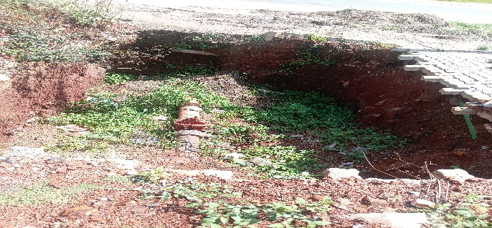
Service Delivery Ward Challenges
Wards | Challenge & area | Responsible Department | Rating | Departmental Response | Commitment Made | Current status/ After picture
Ward 89 | Sinkhole & Olifantsfontein Beka lane Street Ref: | City Planning |  | Outstanding
 | Pothole Olifantsfontein Southward Street Ref:

Slide 57
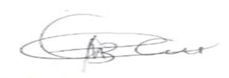
Thank you
11.03.2025

